Slide 1

ES6
Aris Markogiannakis
City University - Short Courses
CS3606 : JavaScript 2: Advanced Javascript for Websites and Web
Notes:
npm install webpack webpack-cli --save-dev

Slide 2
Today
We will go through the following:
Babel
ES6 – ES5 differences
Webpack

Slide 3

ES6
ES6 - also known as Harmony, es-next, ES2015 is the latest finalised specification of the language
ES6 specification was finalized in June 2015
Future versions of the specification will follow the ES[YYYY]
But check the Compatibility Table
http://kangax.github.io/compat-table/es6/

Slide 4

Tooling
ES6 is not supported by all browsers
We need a JavaScript to JavaScript Transpiler
What a transpiler does:
Allow to compile code in the latest version into older versions of the languages
As browser supports gets better, we will transpile ES2016, ES2017 into ES6 and beyond
We will need better source mapping functionality
They’re the most reliable way to run ES6
We use Babel as a transpiler for converting our code from ES6 to ES5

Slide 5
Differences – variables declaration
Var for global variables
Const for values that don’t change
let for variables declaration that will change and only inside blocks.

Slide 6
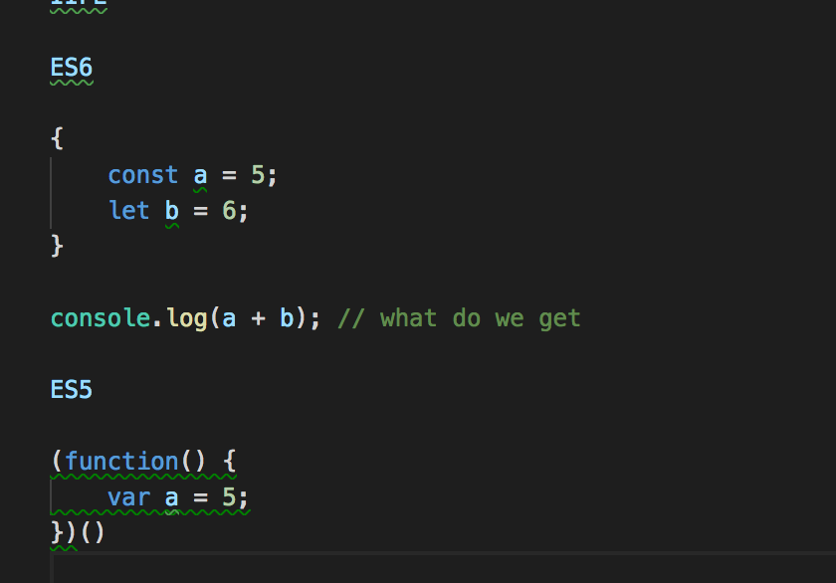
IIFE
An immediately-invoked function expression (or IIFE, pronounced "iffy") is a JavaScript programming language idiom which produces a lexical scope using JavaScript's function scoping.

Slide 7
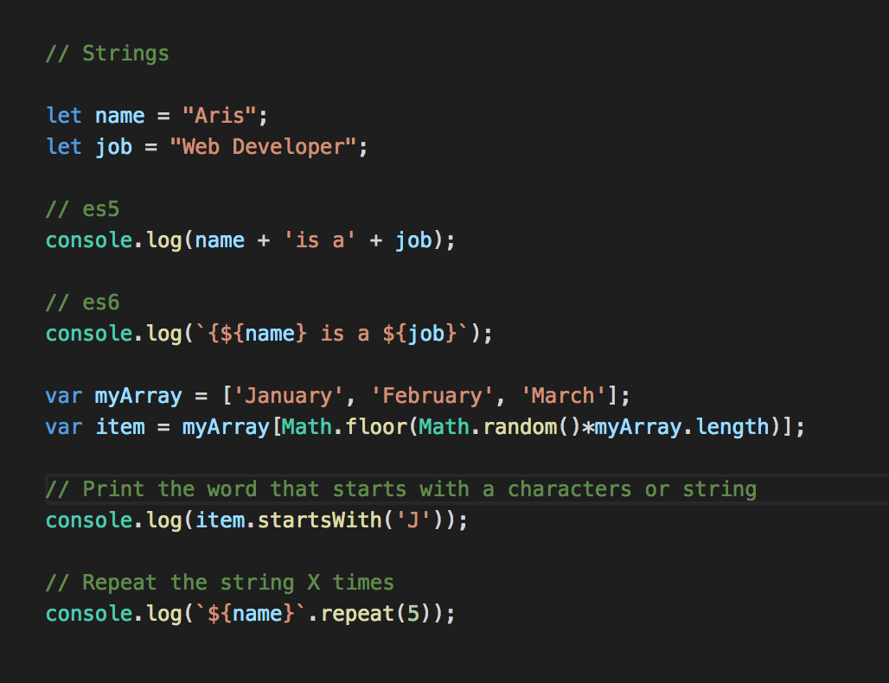
String concatenation
When we want to mix variables with strings and variables

Slide 8
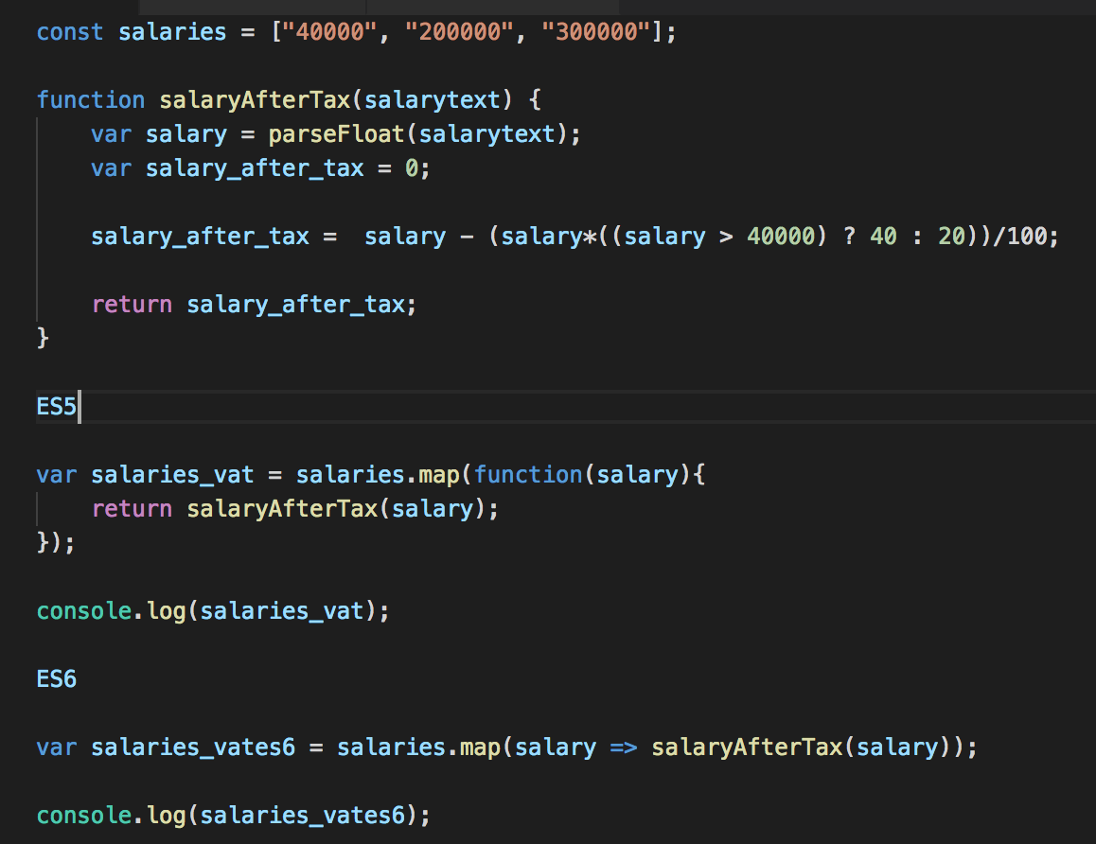
Arrow operators
Arrow functions – also called “fat arrow” functions, from CoffeeScript (a transcompiled language) — are a more concise syntax for writing function expressions. They utilize a new token, => , that looks like a fatarrow. Arrow functions are anonymous and change the way this binds in functions.

Slide 9
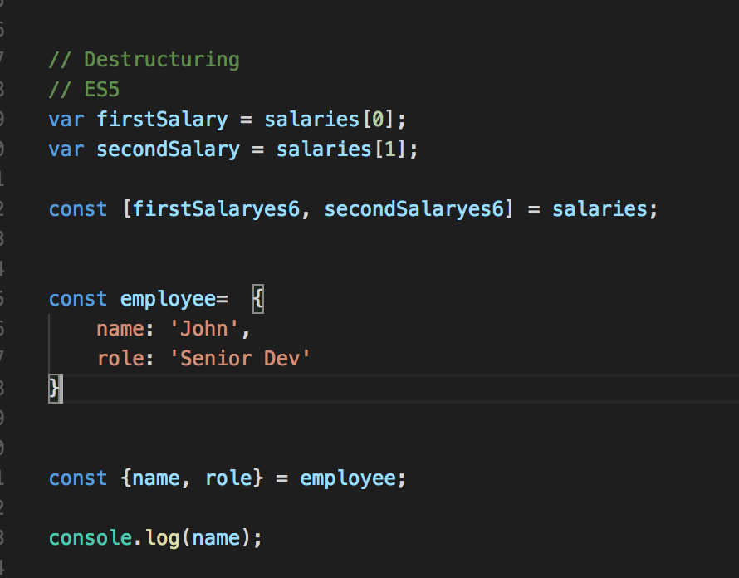
Destructuring
A JavaScript expression that makes it possible to unpack values from arrays, or properties from objects into distinct variables.

Slide 10
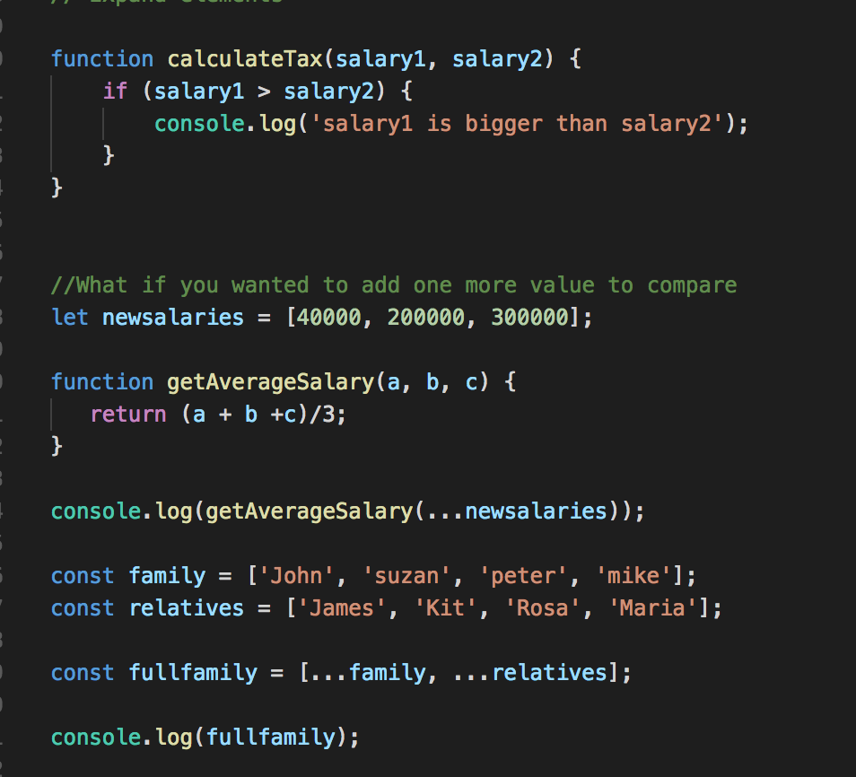
Spread Operators
Allows an iterable such as an array
expression or string to be expanded
in places were zero or more
arguments (for function calls) or
elements (for array literals) are
expected, or an object expression
to be expanded in places where
zero or more key-value.

Slide 11
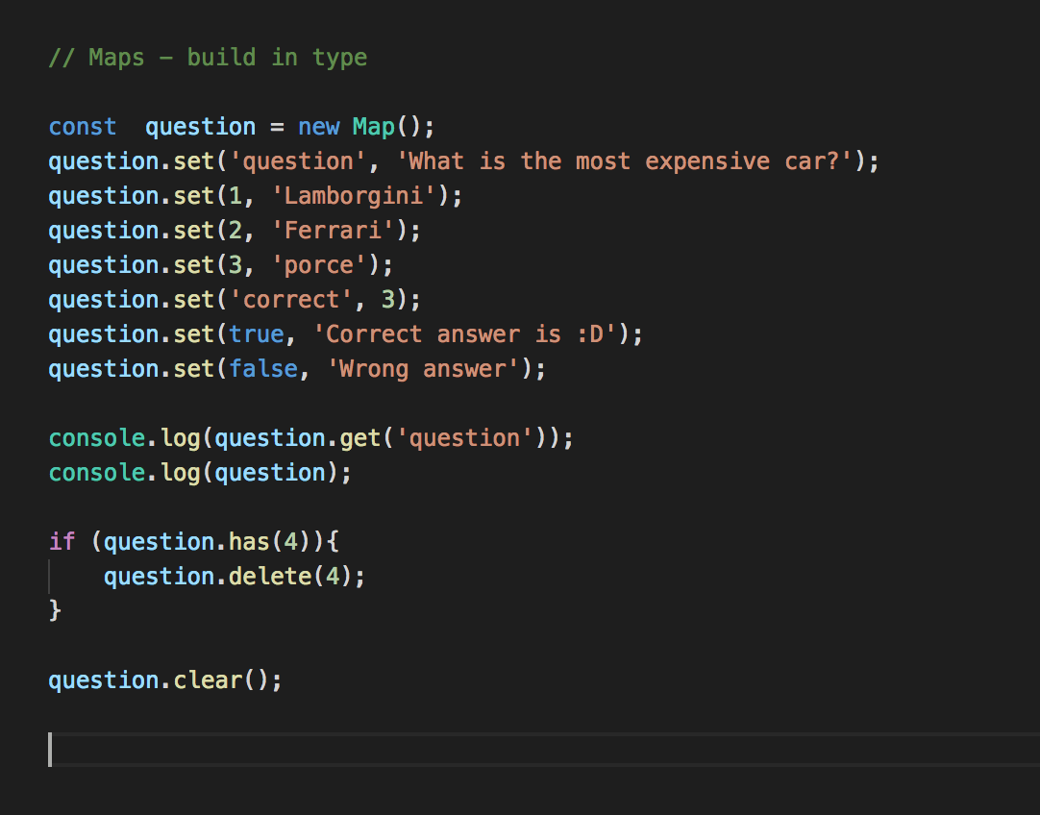
Map
Object holds key-value pairs. Any
value (both objects and primitive
values) may be used as either a key
or a value.

Slide 12
Our first ES6
Before we start we need to install node.js
To install node you this link
To run node you will need to open your command prompt on windows or terminal on mac
Once you have got it installed open the terminal and write the following command:
node -v --- that will return the version of your node

Slide 13
Setting up your project
Create a folder on your projects area let say “myfirstes6”
Open the folder with Visual studio, then from the top menu select View and then Integrated terminal.
Type on your terminal: npm init

Slide 14
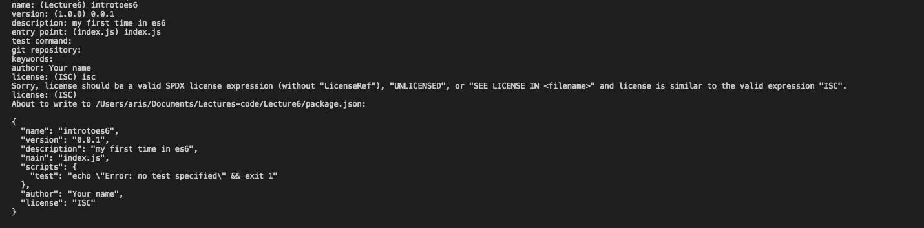
package.json
You will be asked some questions please write back the answers (see an example to your bottom)
This will create a file - package.json on your folder.

Slide 15
Installing babel
We now need to install babel
npm install babel-core babel-loader@7 babel-preset-es2015 webpack --save-dev
Open package.json and add make the changes on the scripts area:
"scripts": {
"webpack": "webpack --mode development",
"start": "http-server"
},
Notes:
npm install webpack webpack-cli --save-dev

Slide 16
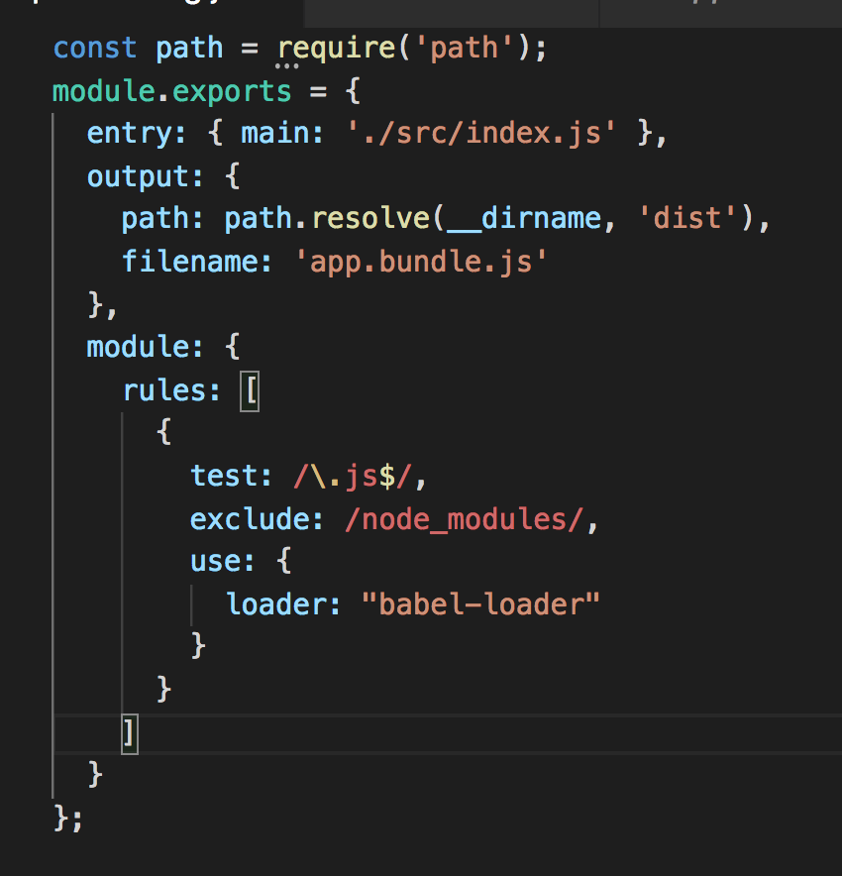
Webpack
Weback is a module that helps us to build our projects
Create inside the main folder a file called webpack.config.js and copy the code from the right.
Create a folder called src and then inside that a folder called app.
Inside the src create a file called index.js

Slide 17
First ES6 class
"use strict";
// Food is a base class
export default class Food {
constructor (name, protein, carbs, fat) {
this.name = name;
this.protein = protein;
this.carbs = carbs;
this.fat = fat;
}
toString () {
return `${this.name} | ${this.protein}g P :: ${this.carbs}g C :: ${this.fat}g F`
}
print () {
console.log( this.toString() );
}
}
Ok we are going to write our first class,
Add inside a file called food.js inside the app.js
Our class has a constructor that sets the instance
And two methods one that returns all the values as string one that prints it

Slide 18
Subclass
import Food from './app/food.js';\
const chicken_breast = new Food('Chicken Breast', 26, 0, 3.5);
chicken_breast.print(); // 'Chicken Breast | 26g P :: 0g C :: 3.5g F'
console.log(chicken_breast.protein); // 26 (LINE A)
Inside your index.js file add the following code.
Because we are using webpack we are able to import our class and then use it to create a new instance

Slide 19
Html file setup
Create an html file at the root of your folder as index.html and add the following code.
On your terminal run
npm run webpack
This command will build your code and minify it and save everything to one file.
Open another tab on your terminal (press the + sign) and run
npm run start
This command will start a webserver on your computer.
Go to your browser on http://localhost:8080
<!doctype html>
<html>
<head>
<title>First es6</title>
<meta charset="UTF-8">
<meta name="description" content="">
<meta name="viewport" content="width=device-width, initial-scale=1">
</head>
<body>
<script src="build/app.bundle.js"></script>
</body>
</html>

Slide 20
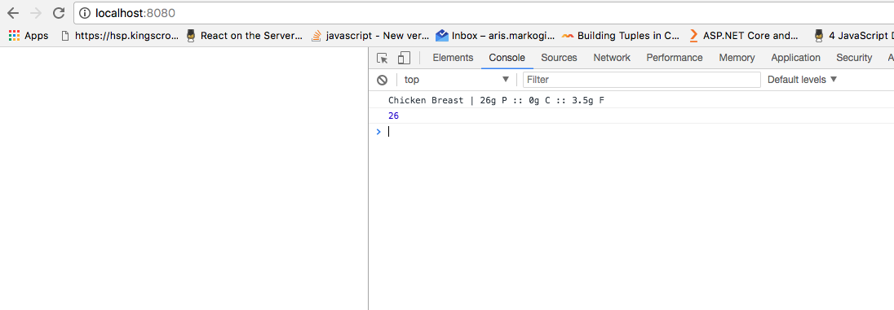
Result
The result is the following

